Slide 1
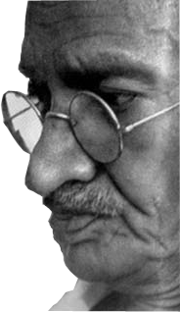
Mahatma Gandhi
‘Nonviolent Resistance is as Relevant as ever’
By
Shobhana Radhakrishna
India
On the Occasion of
International Day of Non Violence 2016
At
Faculty of Letters, Arts & Humanities
University of Manouba Tunisia
4TH October, 2016

Slide 2
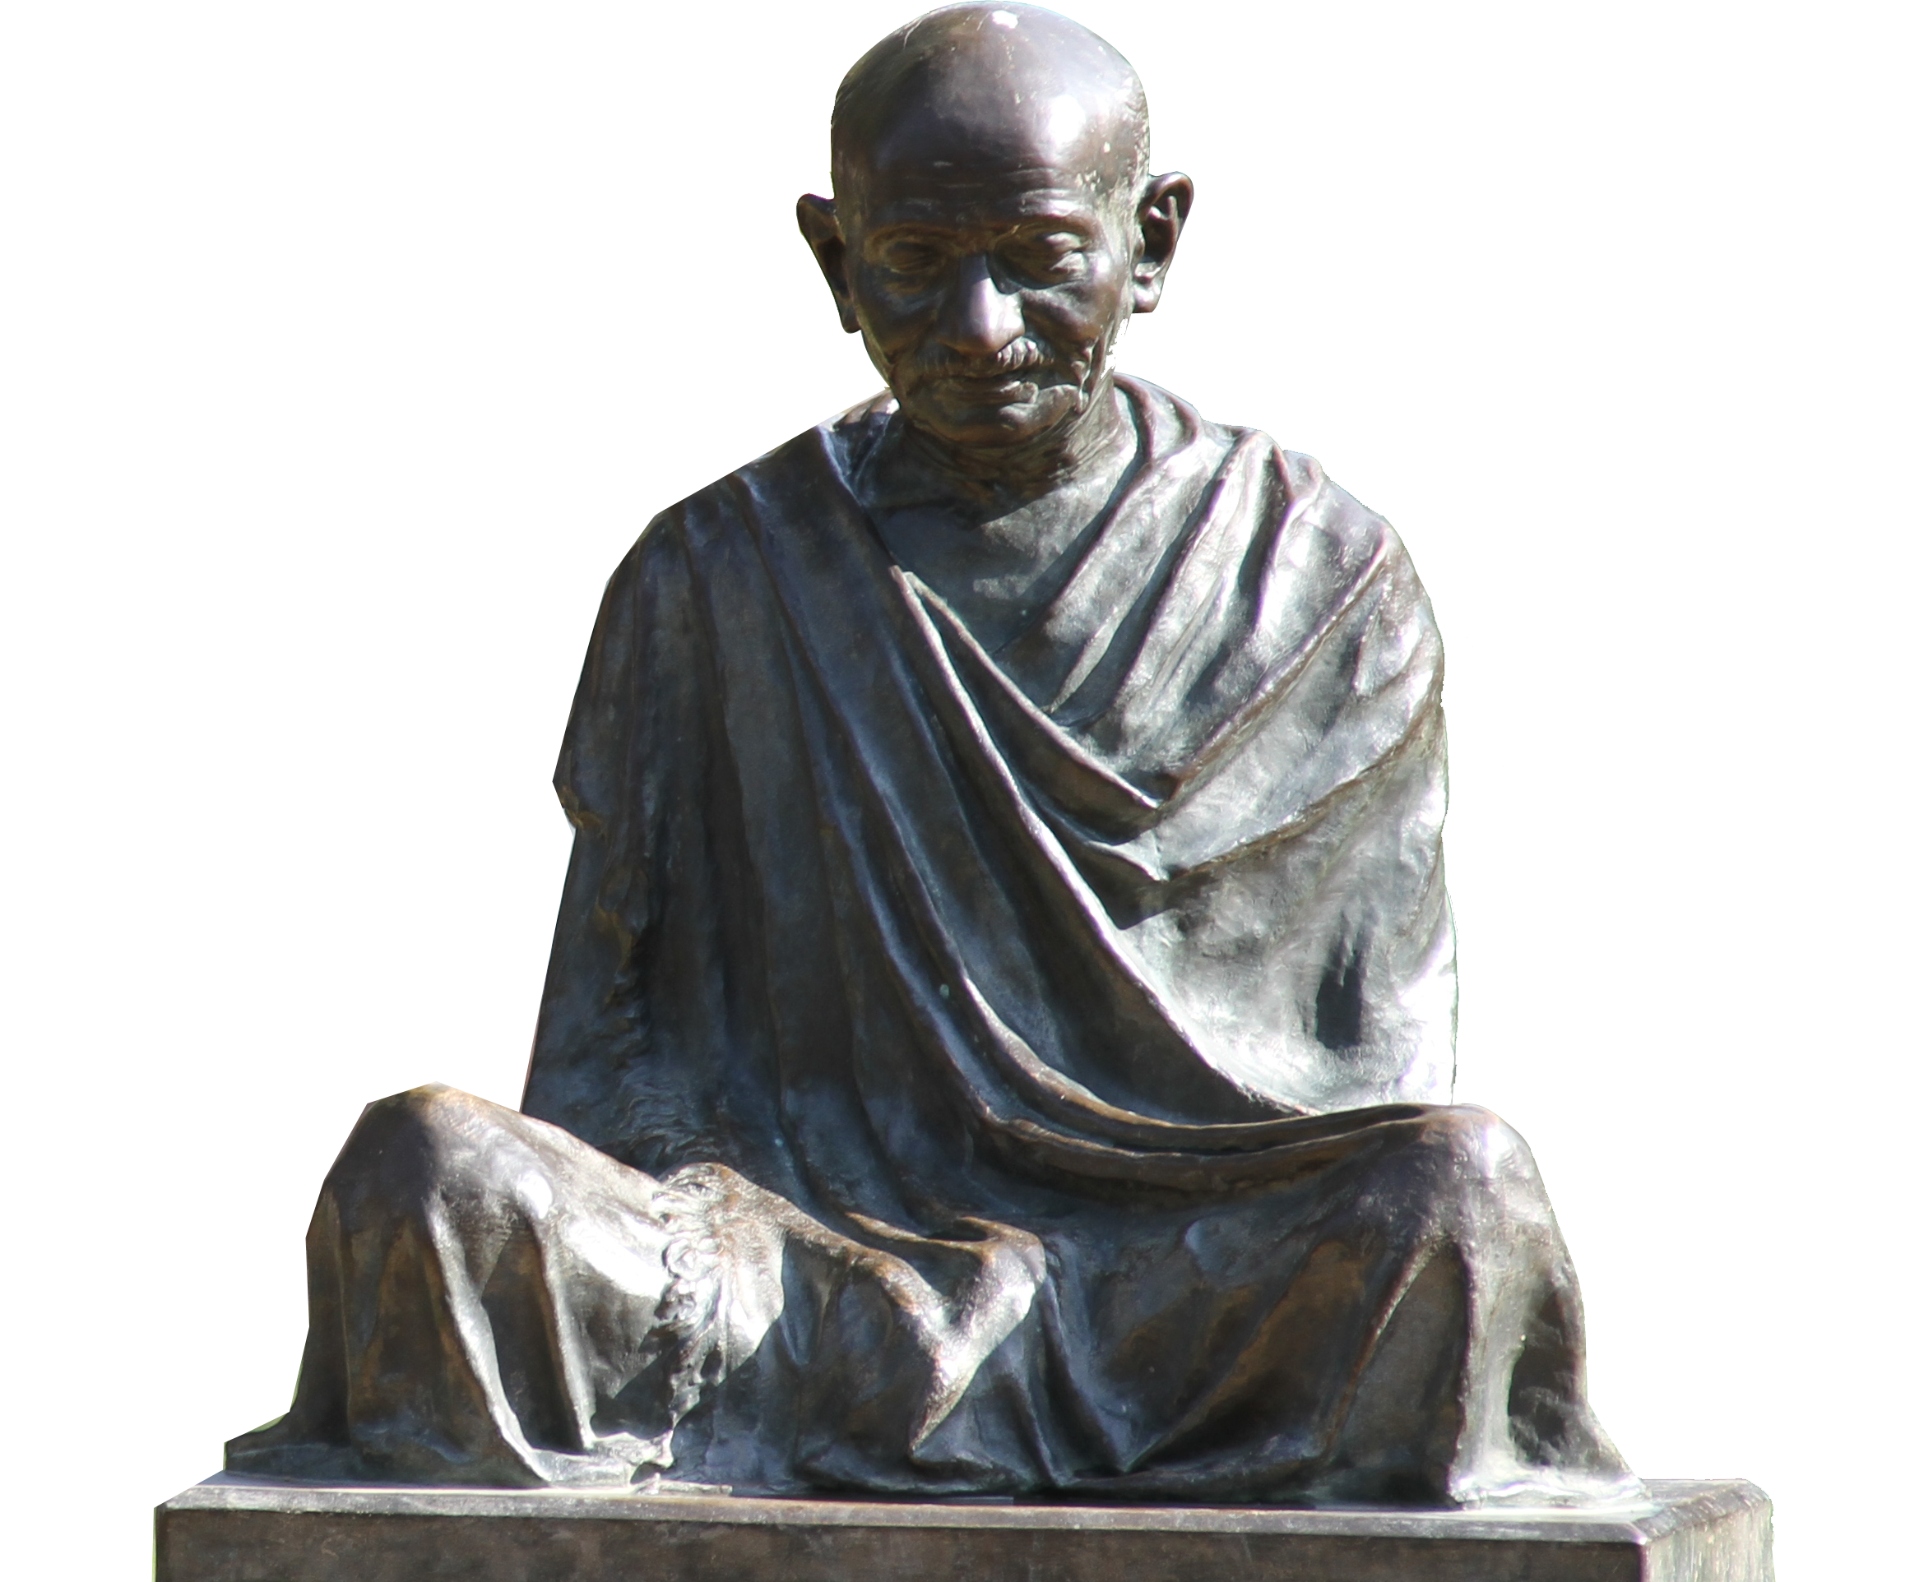
Remembering
Mahatma Gandhi on his 147th Birth Anniversary and International Day of Non Violence 2016

Slide 3
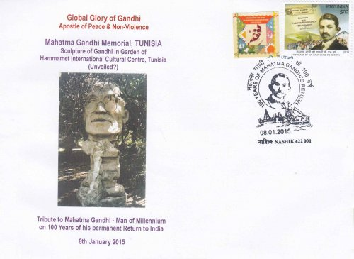
Mahatma Gandhi Memorial Tunisia

Slide 4
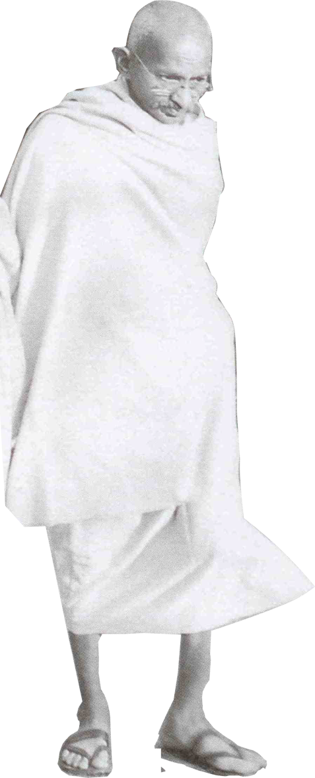
‘Non-violence is the greatest force at the disposal of mankind. It is mightier than the mightiest weapon of destruction devised by the ingenuity of man’
- Mahatma Gandhi

Slide 5
International Day of Non-Violence, 2016 Message from the UN Secretary-General
…We know that a culture of non-violence begins with respect for others, but it does not end there. To nurture peace, we must respect nature. I am pleased this year’s International Day of Non-Violence puts the focus on sustainability and the environment. In all he did, Gandhi honored our obligation to all living things. He reminded us that “Earth provides enough to satisfy everyone’s needs, but not everyone’s greed.” Gandhi also challenged us to “be the change we wish to see in the world”.
- Ban Ki-moon

Slide 6
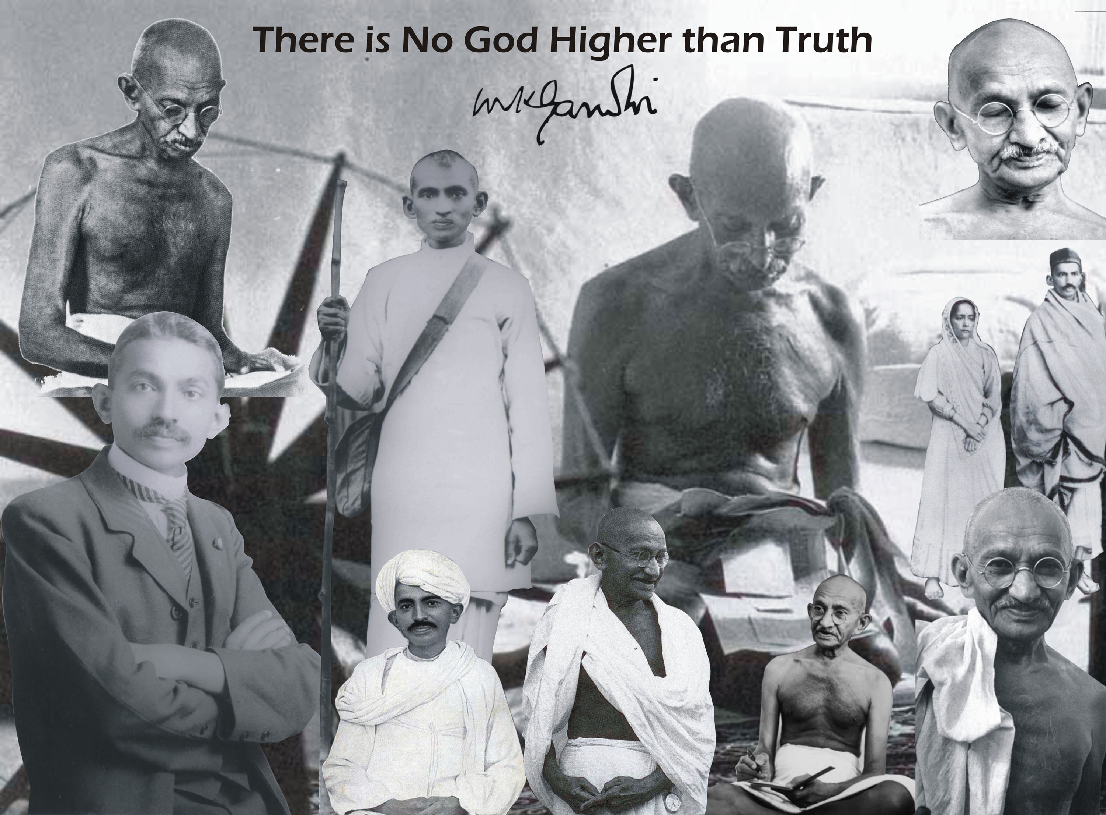

Slide 7
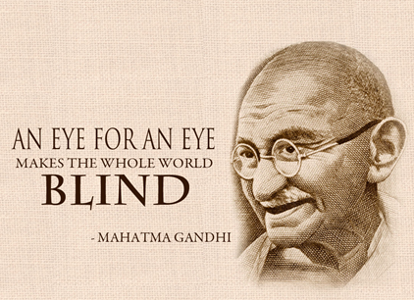

Slide 8
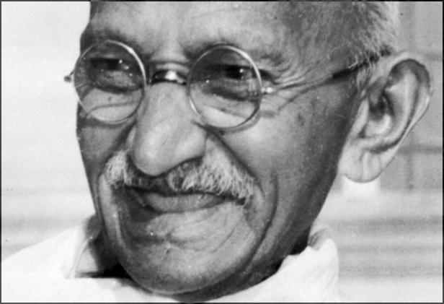
Mahatma Gandhi is the most Powerful Visionary and a Practical Idealist of the 20th Century

Slide 9
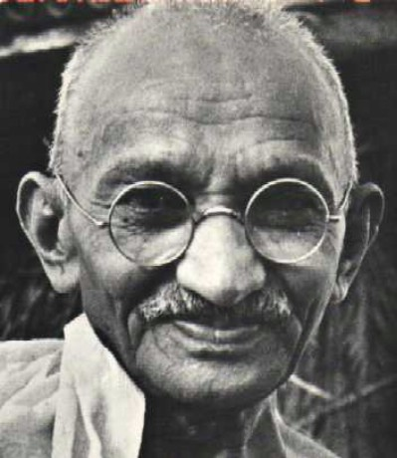
"An ounce of practice is worth more than tons of preaching"
~Mahatma Gandhi

Slide 10
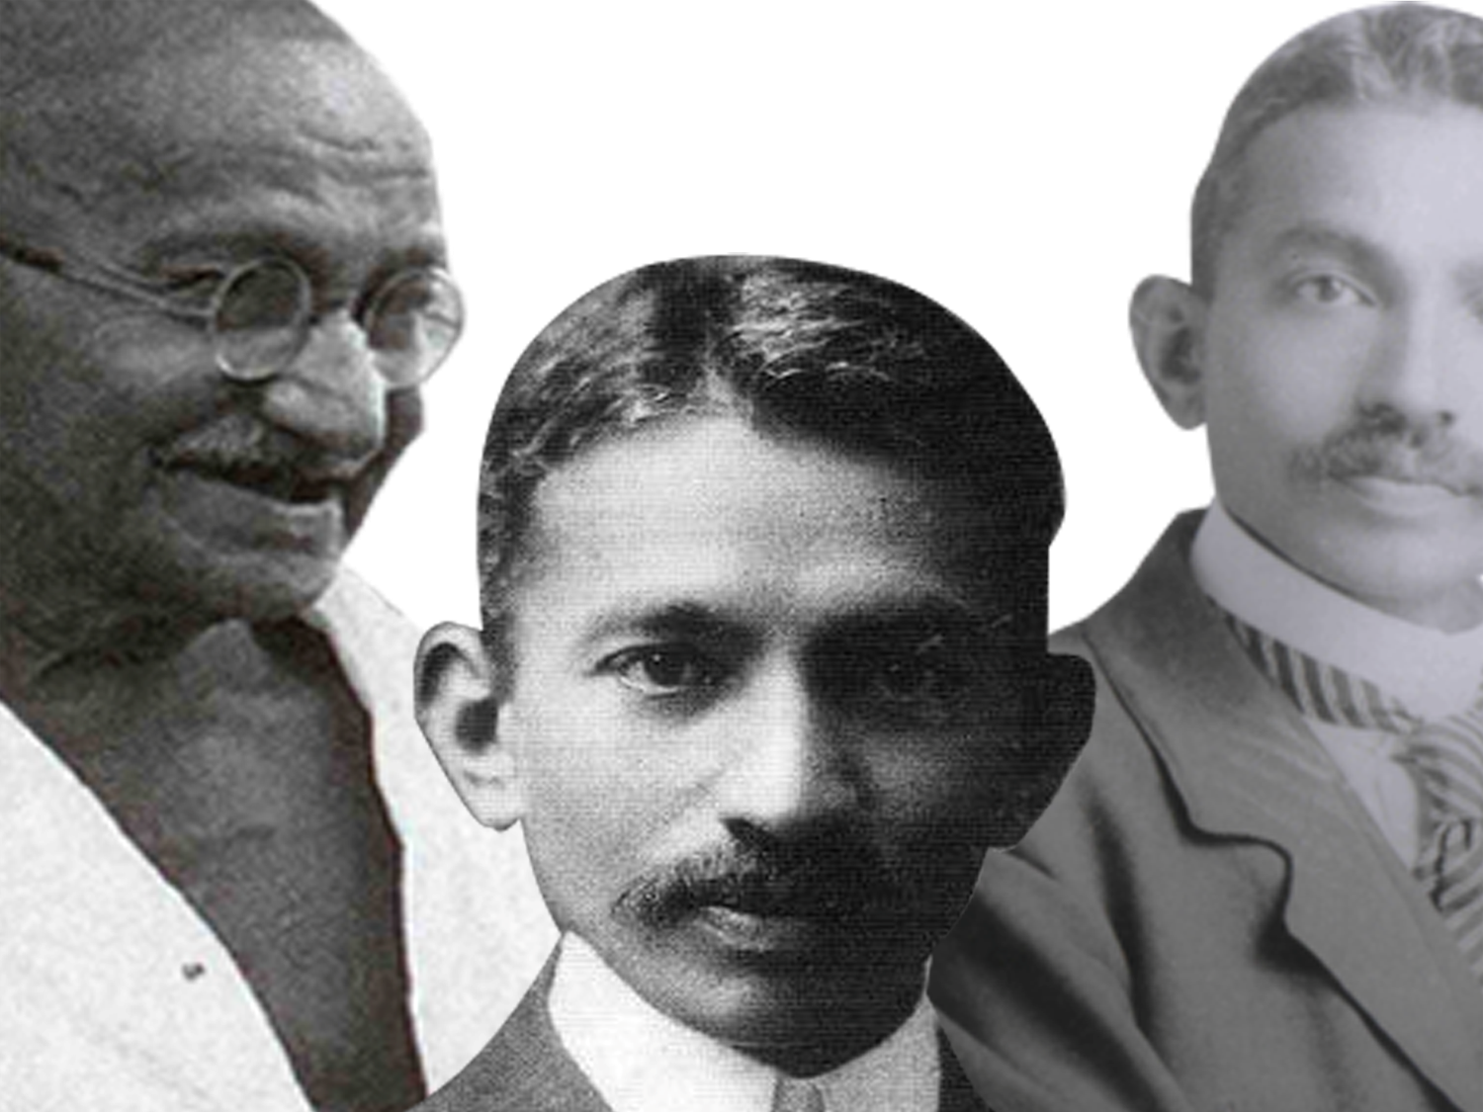
Principles of Mahatma Gandhi
Truth, Non violence & Purity of means

Slide 11
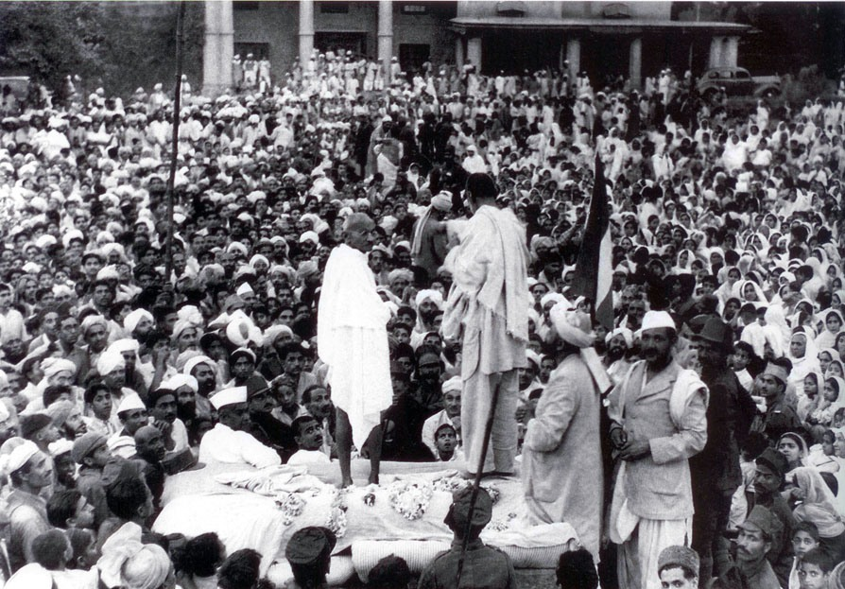
Satyagraha
(Civil Disobedience)
Truth-Force Love-Force Soul-Force

Slide 12
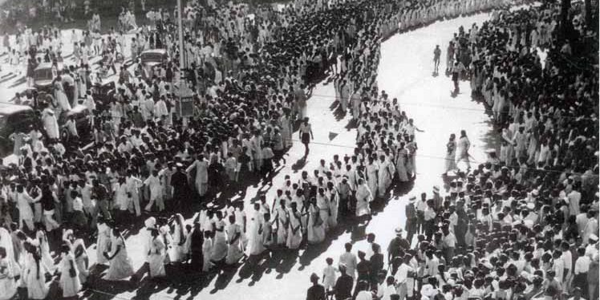
The doctrine of Satygraha may be described in simple words as trying to establish truth or justice through love
When one fails to convince one’s truth to the adversary, instead of trying to establish his truth by coercion or physical force, it tries to communicate by soul force through voluntary suffering

Slide 13
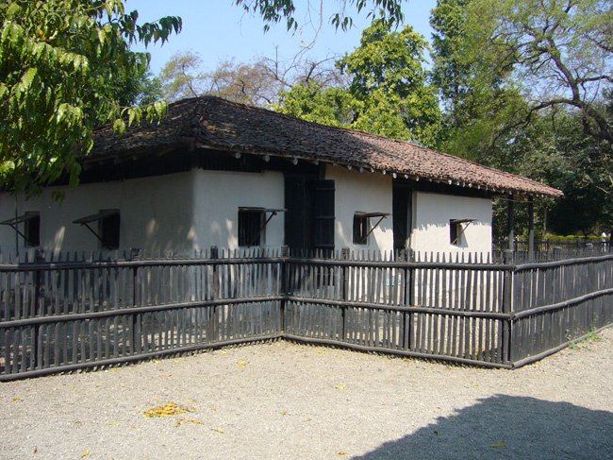
Sewagram Ashram

Slide 14
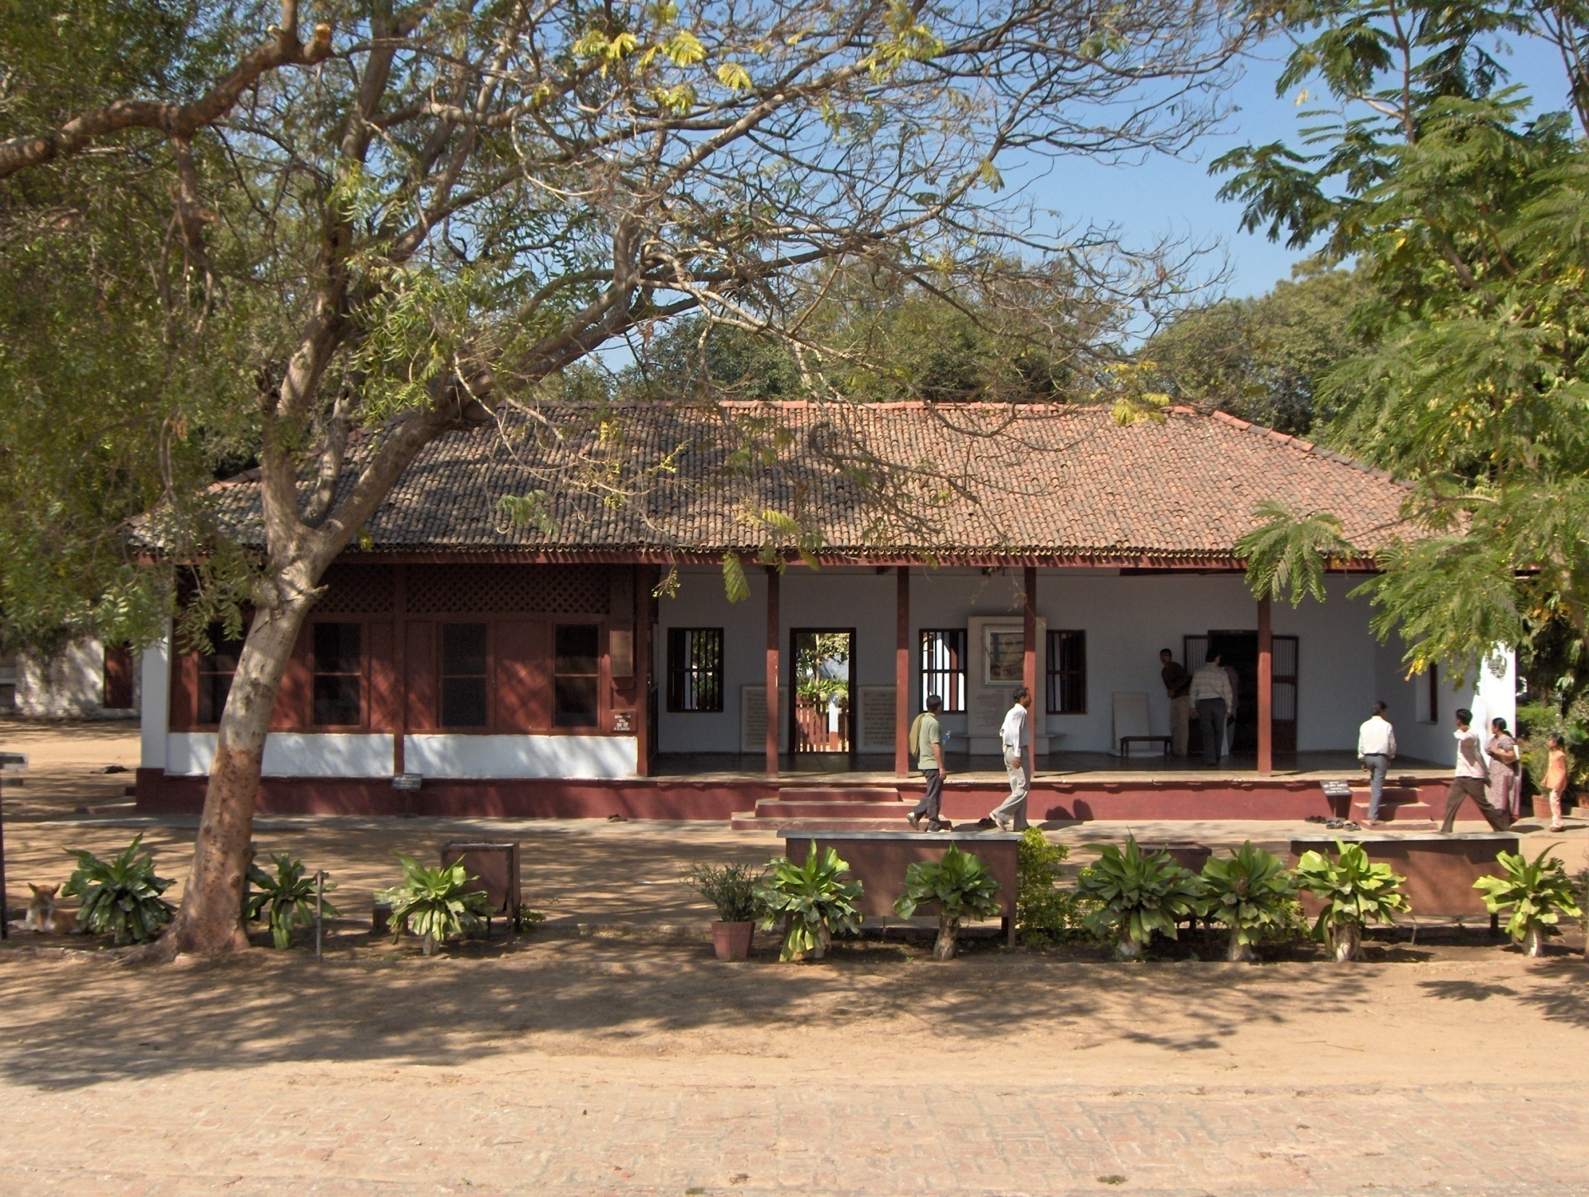
ASHRAMS
PHOENIX AND TOLSTOY
SABARMATI AND SEWAGRAM
Real life practical laboratory of community life, simple living and practicing peace and nonviolence

Slide 15
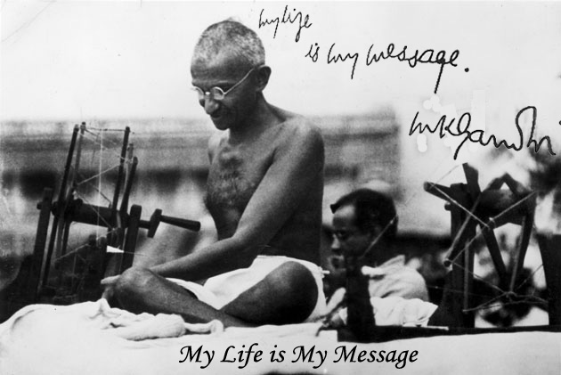

Slide 16
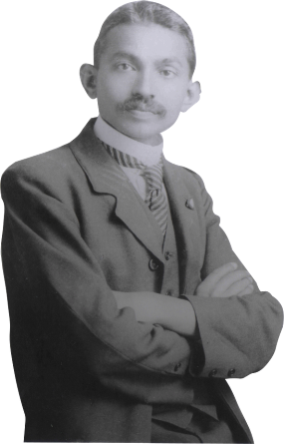
‘to utter as you think and to act as you utter.’
Mahatma Gandhi's definition of Truth

Slide 17
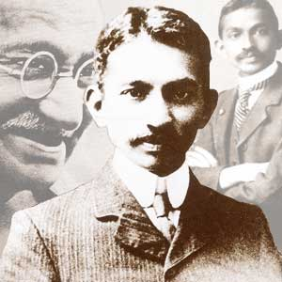
"Non-violence and truth are inseparable and presuppose one another. Non-violence is the article of faith.“
- Mahatma Gandhi

Slide 18
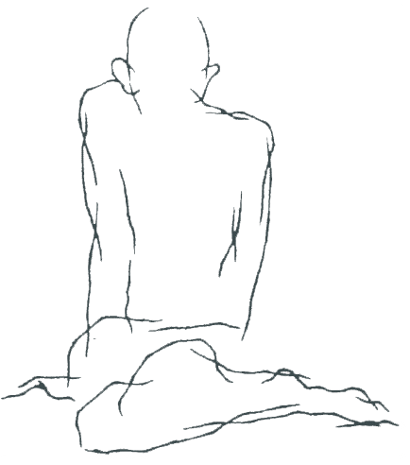
‘Non-violence is the greatest force man has been endowed with. Truth is the only goal he has. For God is none other than truth. But truth cannot be, never will be, and reached except through non-violence. That which distinguishes man from other animals is his capacity to be non-violent. And he fulfills his mission only to the extent that he is non-violent and no more. He has no doubt many other gifts. But if they do not sub serve that main purpose - the development of the spirit of non-violence in him –they but drag him down lower than the brute, a status from which he has just emerged. The cry for peace will be a cry in the wilderness, so long as the spirit of non-violence does not dominate millions of men and women.’
– Mahatma Gandhi

Slide 19
‘Non-violence is the law of our species as violence is the law of the brute. The spirit lies dormant in the brute and he knows no law but the law but of physical might. The dignity of man requires obedience to a high law -that of the spirit, it is the law of love that rules the mankind. Had violence i.e. hate ruled us, we should have become extinct long ago. Mankind has to get out of violence only through non-violence. Hatred can be only overcome by love.’
- Mahatma Gandhi

Slide 20
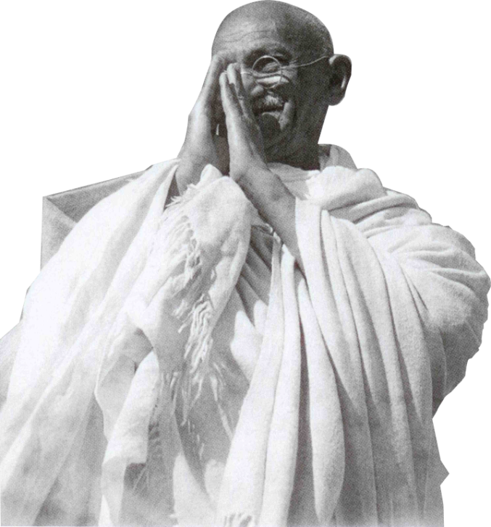
Mahatma Gandhi has reassured us saying,
‘I am not going to keep quite even after I die, I will proclaim my faith even in death and speak from the grave’

Slide 21
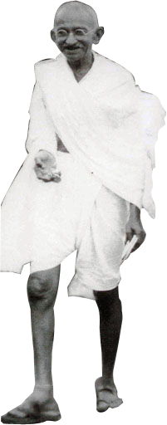
‘What was this faith that he wished to proclaim from the grave?
‘It was faith in Truth; that was GOD. It was faith in the goodness of all, as all are capable of truth. It was faith in the history of mankind, it was faith that despite the falls and upheavals it moved towards goodness, because Truth, that is God is also auspicious.’

Slide 22
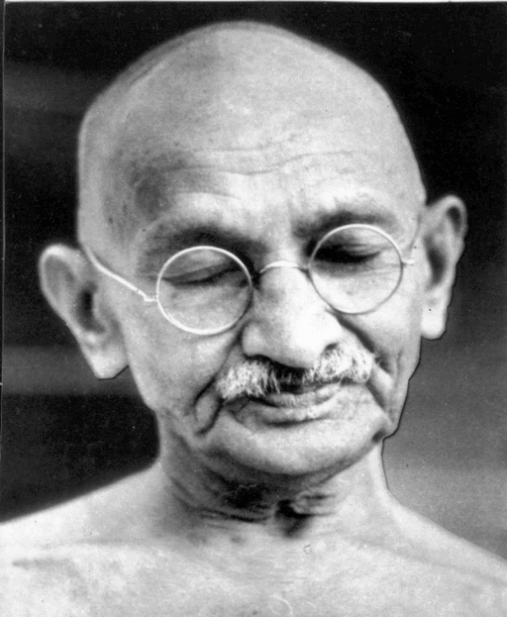
68 years after violence brought his life to an abrupt end; it is a life worth revisiting. Mahatma Gandhi’s life reminds us that the peace is a positive force and that it can still move the human race away from darkness towards light

Slide 23
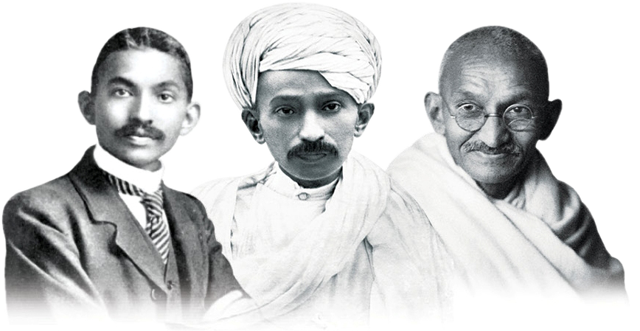
‘We must become the change we want to see in the world.’
- Mahatma Gandhi

Slide 24
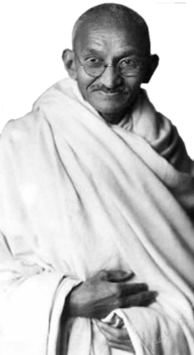
‘You must not lose faith in humanity. Humanity is an ocean; if a few drops of the ocean are dirty; the ocean does not become dirty’
- Mahatma Gandhi

Slide 25

Gandhi's Talisman
“I will give you a talisman. Whenever you are in doubt, or when the self becomes too much with you, apply the following test.
Recall the face of the poorest and the weakest man [woman] whom you may have seen, and ask yourself, if the step you contemplate is going to be of any use to him [her]. Will he [she] gain anything by it? Will it restore him [her] to a control over his [her] own life and destiny? In other words, will it lead to swaraj [freedom] for the hungry and spiritually starving millions?
Then you will find your doubts and your self melt away.”
(One of the last notes left behind by Gandhi in 1948, expressing his deepest social thought.)

Slide 26
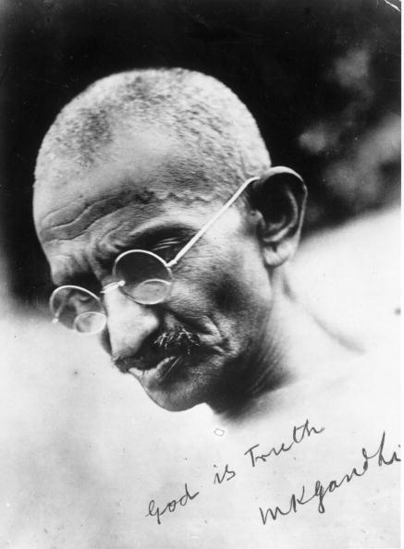
‘The best way to find yourself is to lose yourself in the service of others’
~Mahatma Gandhi

Slide 27
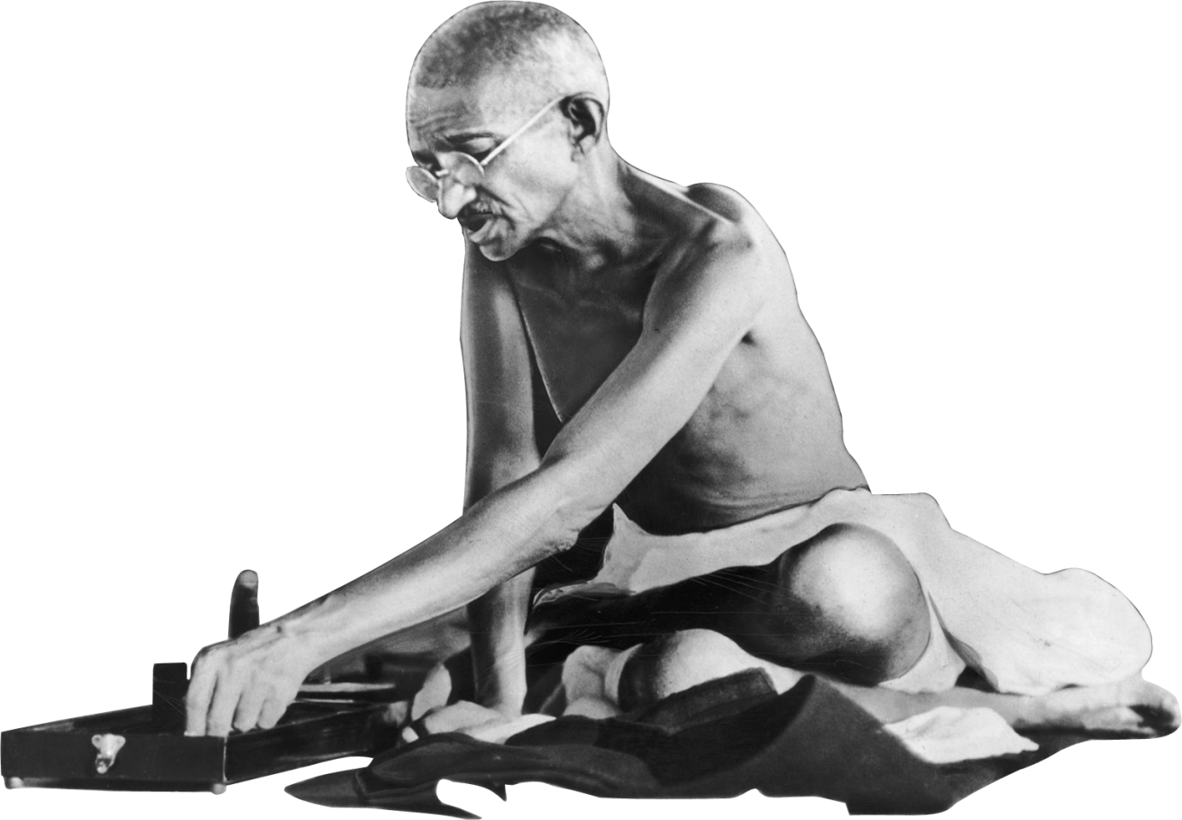
‘First they ignore you, then laugh at you, then they fight, then you win.’
~Mahatma Gandhi

Slide 28
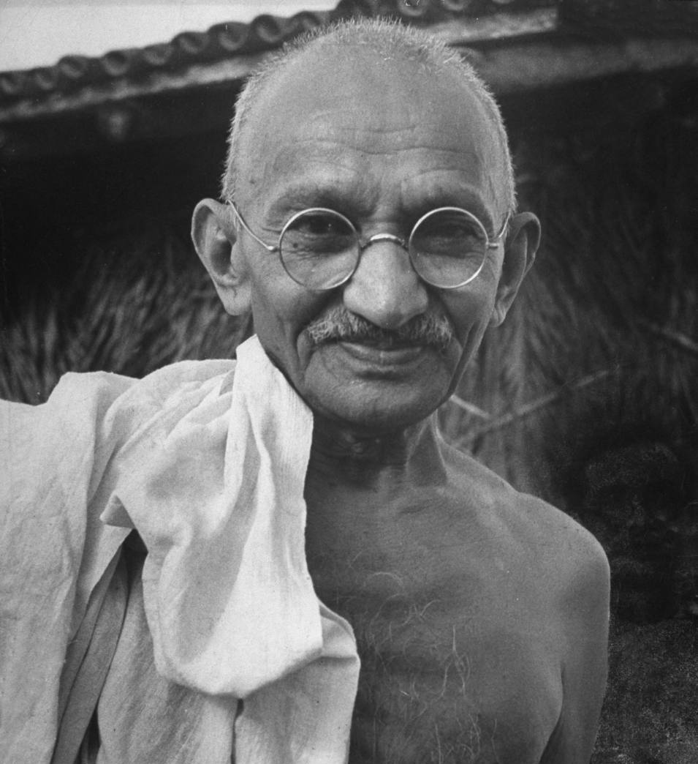
‘Facts mean truth, and once we adhere to truth, the law comes to our aid naturally’
- Mahatma Gandhi
► Gandhiji A/V
► Prayer
►Ashram

